Slide 1
thebricktestament.com
Creation
Genesis 1:1

Slide 2
The Fall Genesis 3:6 Genesis 3:15
thebricktestament.com

Slide 3
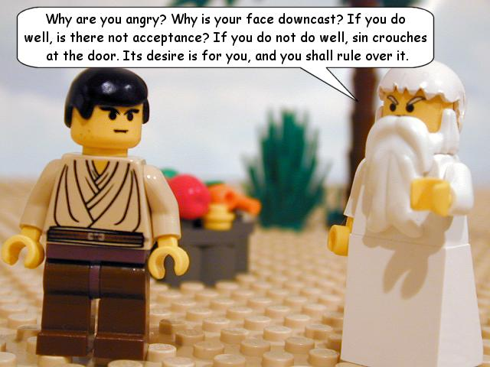
Cain and Abel Genesis 4:6-7
thebricktestament.com

Slide 4
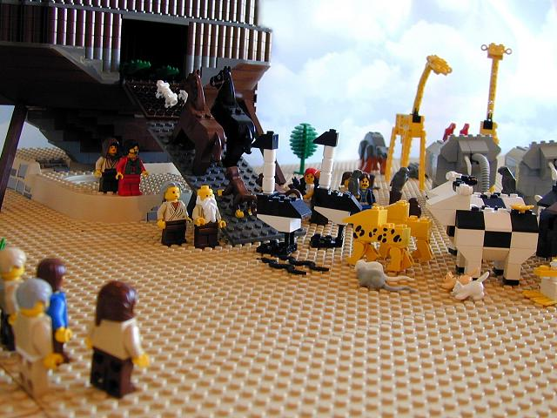
The Flood Genesis 7:17
thebricktestament.com

Slide 5
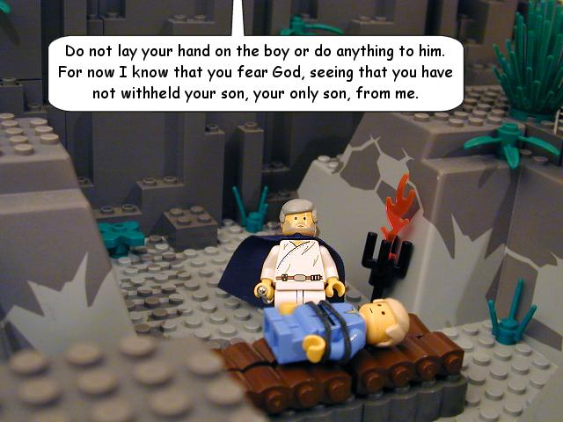
The Testing of Abraham Genesis 22:2
thebricktestament.com

Slide 6
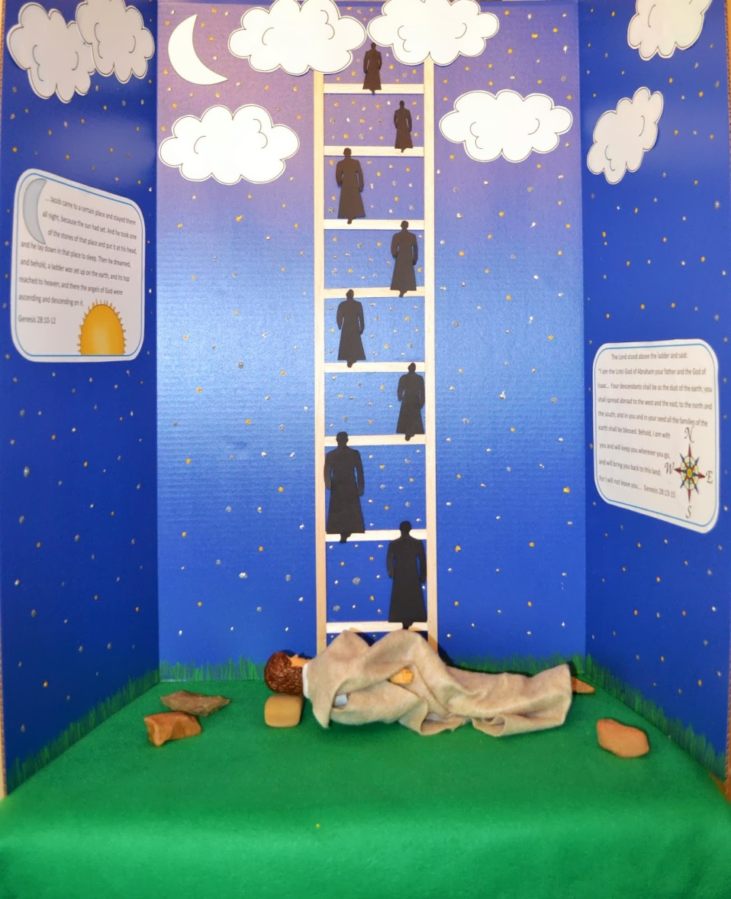
Jacob’s Ladder Genesis 28:12
kidsbibledebjackson.blogspot.com

Slide 7
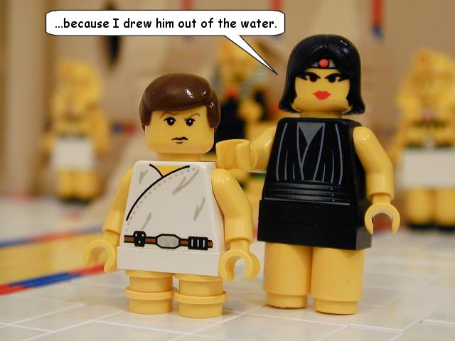
Moses is Rescued Exodus 2:5
thebricktestament.com

Slide 8
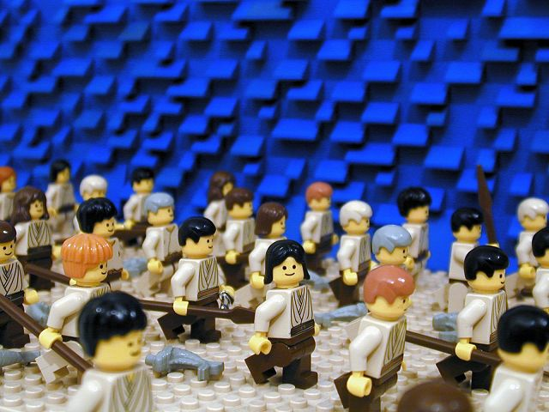
Crossing the Red Sea Exodus 14:16
thebricktestament.com

Slide 9
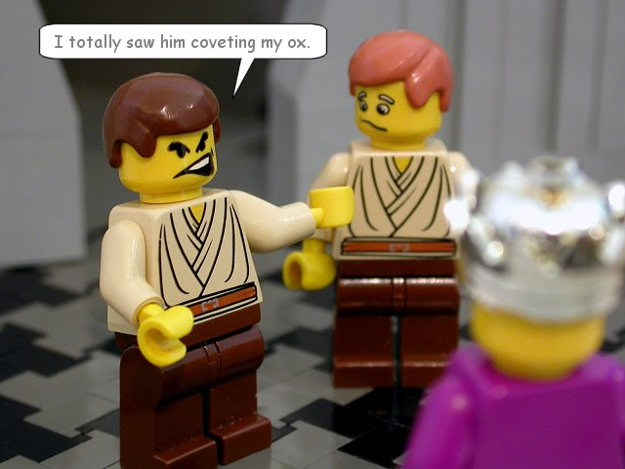
10 Commandments Exodus 20:1-17
thebricktestament.com

Slide 10
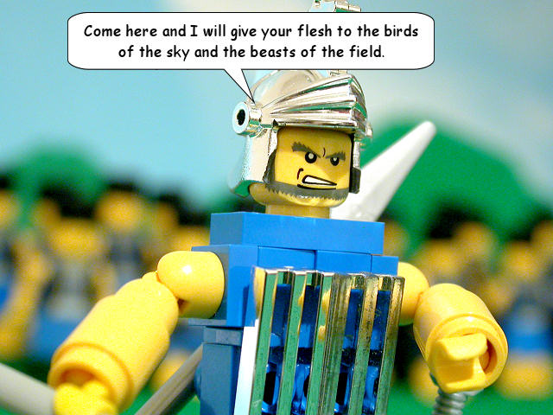
David and Goliath 1 Samuel 17:31-51
thebricktestament.com

Slide 11
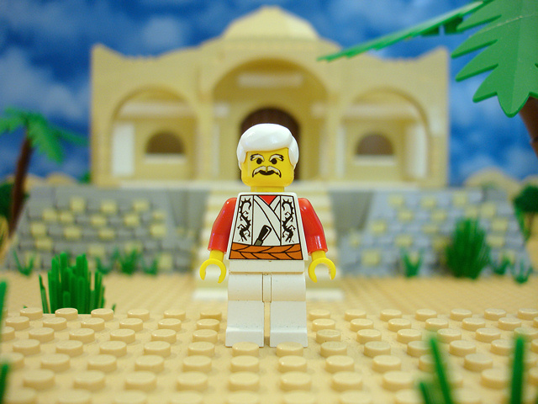
The Story of Job Job
thebricktestament.com

Slide 12
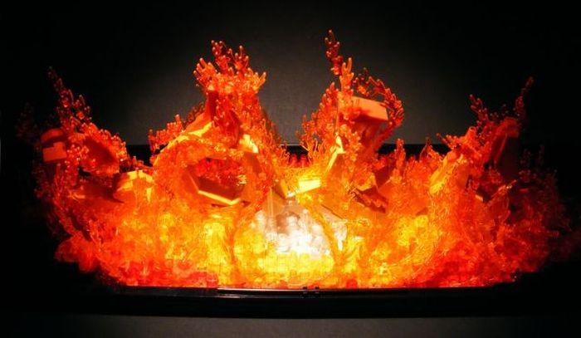
Shadrach, Meshach, Abednago Daniel 3
thebricktestament.com

Slide 13
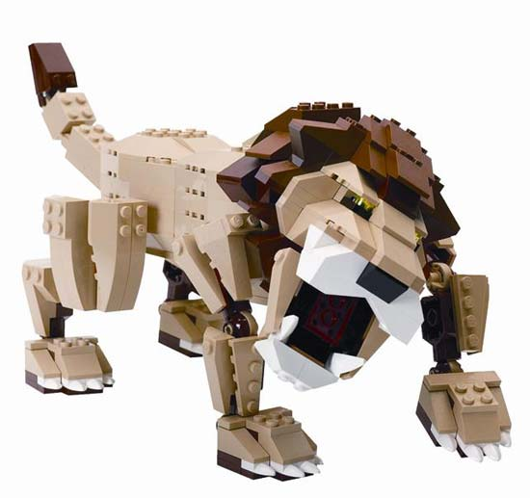
Daniel and the Lion’s Den Daniel 6
www.motherearthnews.com

Slide 14
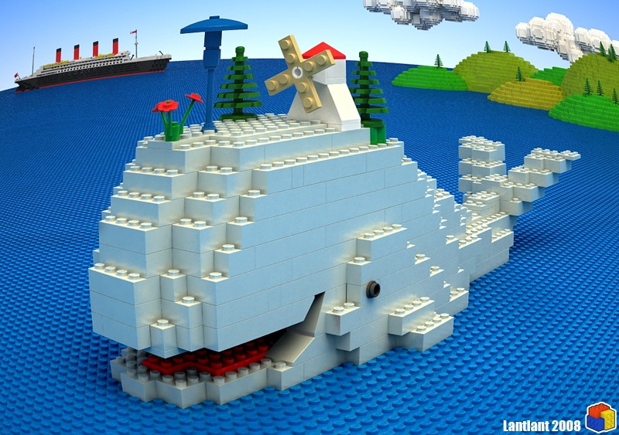
Jonah and the Whale Jonah 1:12-17
www.deviantart.com

Slide 15
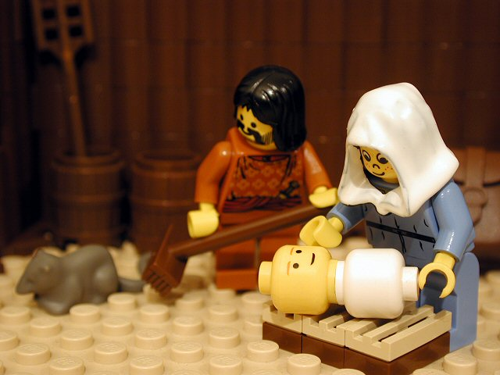
Birth of Christ Matthew 1
thebricktestament.com

Slide 16
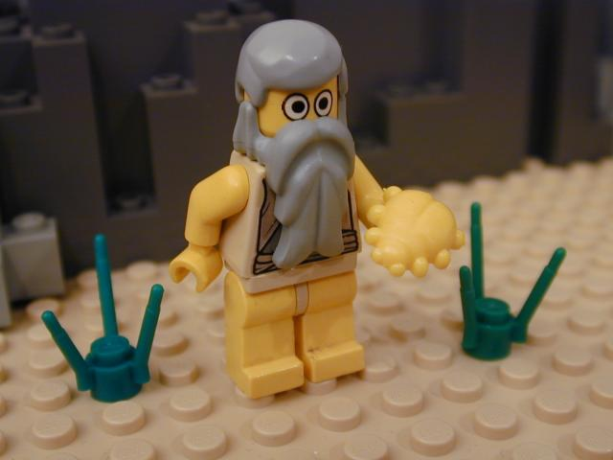
John the Baptist Prepares the Way Matthew 3
thebricktestament.com

Slide 17
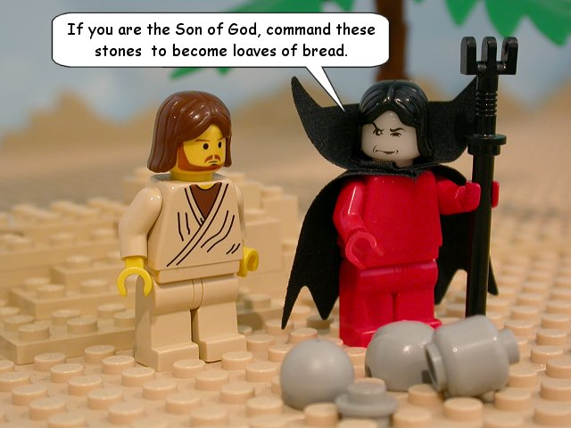
Temptation of Christ Matthew 4:1-11
thebricktestament.com

Slide 18
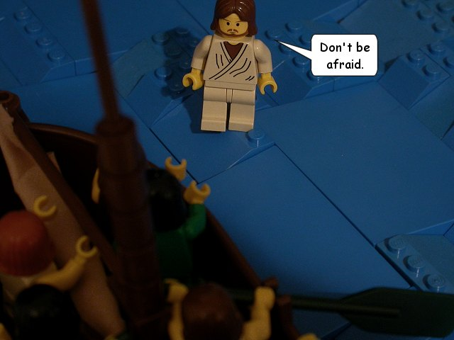
Jesus walks on water Matthew 14:22
thebricktestament.com

Slide 19
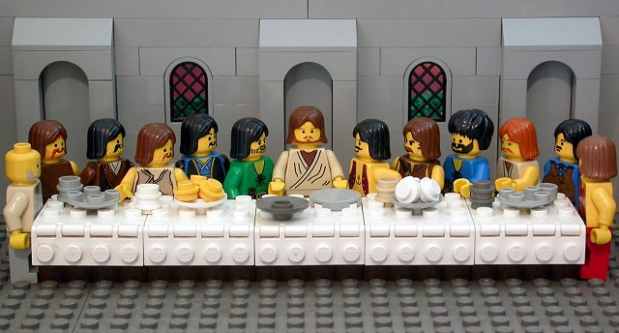
The Last Supper Luke 22:7-38
thebricktestament.com

Slide 20
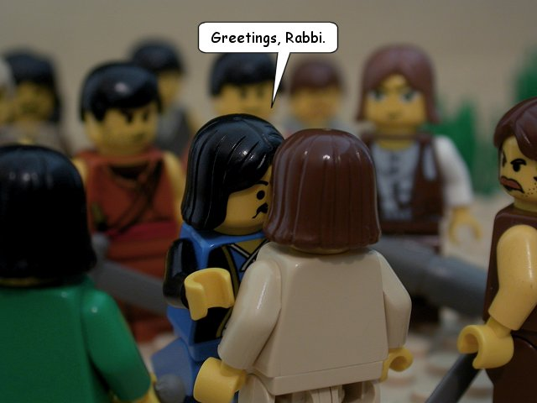
Christ’s Betrayal John 18
thebricktestament.com

Slide 21
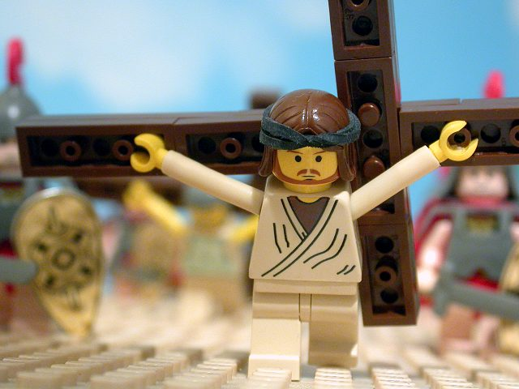
Jesus’ Crucifixion John 19:17-42
thebricktestament.com

Slide 22
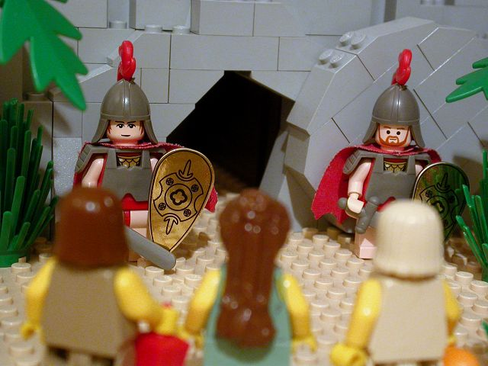
The Resurrection John 20
thebricktestament.com

Slide 23
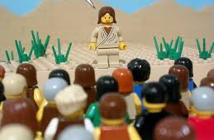
The Great Commission Matthew 28:16-20
thebricktestament.com

Slide 24
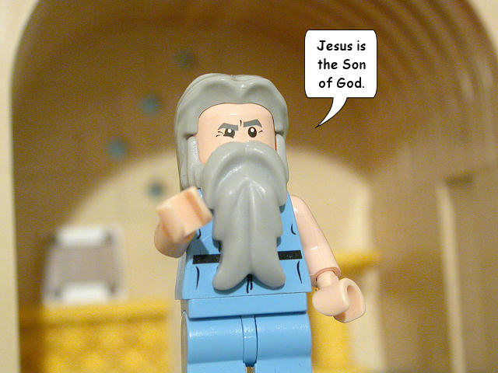
Paul’s Conversion Acts 9
thebricktestament.com

Slide 25
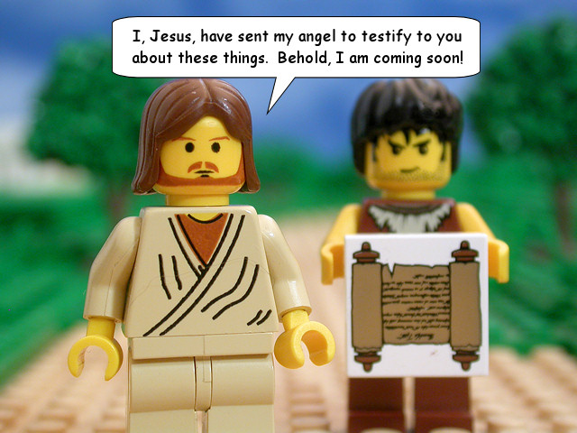
Jesus is coming back! Revelation 22:20
thebricktestament.com

